Slide 1
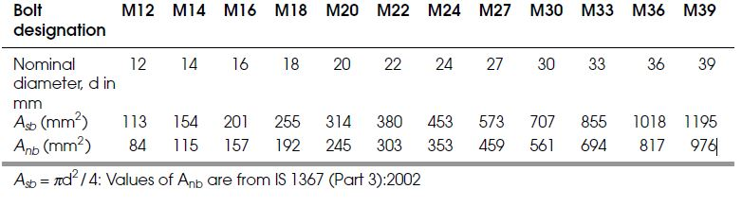

Design Specifications for Bolted Connections as per IS 800:2007
Shear Capacity of a Bolt
The design strength of a bolt in shear V_{dsb} is given by V_{dsb} = V_{nsb} /g _{mb}
Sectional area of shank (Asb ) and net shear area or net tensile stress area (Anb ) of bolts
where
V_{nsb} = the nominal shear capacity of a bolt is

Slide 2


2. Bearing Capacity of a Bolt
The design strength of a bolt in bearing Vdpb is given by
Vdpb = Vnpb/g mb
Where
V_{npb} = the nominal bearing strength of a bolt = 2.5kb dtf_{u}
kb is the smallest of
3. Tension capacity of plate
The design strength of a plate in tension due to rupture at the net section T_{dn} = 0.9 An f_{u} /g_{m1}
4. Design Strength Due to Block Shear
The block shear strength T_{db} of the bolted connection is the least of

Slide 3
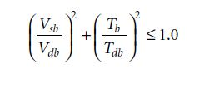
5. Tension Capacity of a Bolt
The design strength of a bolt in tension T_{db} is the least of
A. the design strength of the bolt due to the yielding of the gross section (i.e., the shank)
= T_{dbg} = f_{yb} A_{sb} / g _{m0}
B. the design strength of the bolt due to the rupture at the net section, (i.e., at the root ofthe threads)
= T_{dbn} = 0.9 f_{ub} A_{nb} / g _{mb}
6. Bolt Subjected to Combined Shear and Tension
A bolt subjected to shear and tension simultaneously should satisfy the condition
Other Specifications
1. The diameter of the hole should be the nominal diameter of the bolt plus the clearance as given below.
The nominal diameter of the bolt (mm) : 12—14 16—24 >24
The standard clearance (mm) : 1.0 2.0 3.0
2. The minimum pitch: The distance between the centers of the bolts in the direction of stress should not be less than 2.5 times the nominal diameter of the bolt.

Slide 4

3. The maximum pitch:
(i) 32t or 300 mm, whichever is less for the bolts in members including the tacking bolts,
(ii) 16t or 200 mm, whichever is less for the bolts in tension members,
(iii) 12t or 200 mm, whichever is less for the bolts in compression members where t is the thickness of the thinner plate.
4. The edge and end distances:
The minimum edge and end distances from the center of any hole to the nearest edge of a plate should not be less than 1.7 times the hole diameter for sheared or hand-ß ame cut edges; and 1.5 times the hole diameter for rolled, machine-ß ame cut, sawn and planed edges.
(ii) The maximum edge distance from the center of the hole to the nearest edge should not exceed 12te, where e and t is the thickness of the thinner outer plate.
5. Tacking bolts:
These are the additional bolts provided other than strength consideration. They are usually provided to inter-connect two or more members. The maximum pitch of these bolts should be 32t or 300 mm, whichever is less, where t is the thickness of the thinner plate. If the members are exposed to weather, the pitch should not exceed 16 times the thickness of the outside plate or 200 mm, whichever is less.

Slide 5
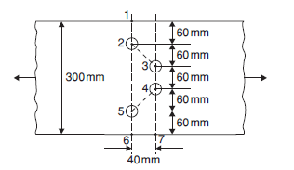
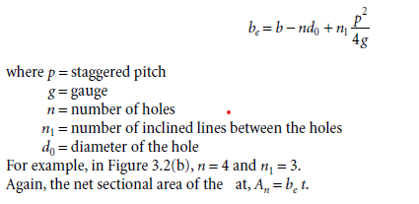
Q Determine the minimum net area of cross-section of 300 × 12 mm at shown in fig.
The holes are of diameter 17.5 mm.
Pitch (p) = 40 mm
Gauge (g) = 60 mm
Net effective width be along the net section 1-2-5-6 =
Net effective width be along the net section 1-2-3-4-7 =
Net effective width be along the net section 1-2-3-4-5-6 =
Minimum net area of the section =

Slide 6
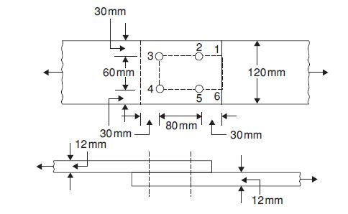
Qsn.
Determine the ultimate load-carrying capacity in the tension of the lap joint shown in fig. if the bolt threads are outside the shear plane. Use M18 bolts of product grade C and property class 4.6. The yield and ultimate strengths of the plats are 250 MPa and 410MPa, respectively.
Solution. Bolt dia. =18mm
The diameter of the hole = 18 + 2 = 20 mm
Min. Edge distance =1.7*d_{o} = 34mm
Max. edge = 12te or 12*12*(250/400)^{0.5} = 113.8mm
edge provided = 35mm
Min. pitch = 2.5*18=45mm
Max. pitch =16*12 or 200 = 192mm
Pitch provide is 80mm
Since property class of bolt is 4.6, f_{ub} = 400 MPa
The design strength of the plate due to rupture at the net section,
T_{dn} = 0.9 An f_{u}/ g _{m1}
= 0.9 {(120 -2*20) *12}* 410/1.25 or = 0.9 {(120 -1*20) *12}* 410/1.25
= 283.392 KN or 354.24 KN
Yield strength of plate = Tdg = Ag fy / g _{m0 =} 120*12*250/1.1 = 327.272KN
V_{nsb} = f_{ub}/sqrt3(n_{n}A_{nb}+ n_{s}A_{sb})= 400/sqrt3(1*192+0*255) = 44.34KN
The design shear strength of the bolt,
V_{dsb} = V_{nsb} / g _{mb} = 44.34/1.25 = 35.47KN
Tearing Strength = 120
35
50
35
35

Slide 7

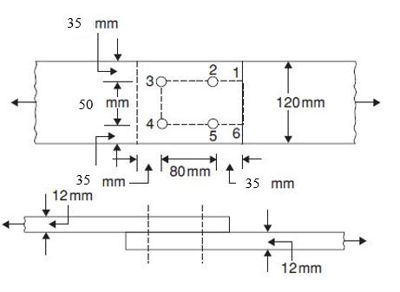


35/3*20,(80/3*20-.25),400/410,1 =.583, 1.078, .97,1 so kb = 0.583
V_{npb} = 2.5 k_{b} dt f_{u} = 2.5*0.583*18*12*410 = 129.076 KN
The design bearing strength of the bolt, V_{dpb} = V_{npb} / g _{mb} = 129.076/1.25 = 103.26 KN
Bolt value = (Least value of V_{dsb} and V_{dpb}) = 37.14 KN
The design strength of the connection in the shear or bearing
= 4*(Least value of V_{dsb} and V_{dpb}) =37.14KN
4*37.14 = 148.56 KN/ 8*37.14 = 297.12KN
So plate capacity is min. (283.39, 327.27 ,297.12) = 283.39 KN
A_{vg} = 2*(80 + 30)*12 = 2640 mm2 *(along 1 - 2 - 3 and 4 -5 - 6)
A_{vn} = 2(80 + 30 -1.5*18)*12 = 1992 mm2 * (along 1-2-3 and 4 - 5 - 6)
A_{tg} = 60*12 = 720 mm2 *(along 3 -4)
A_{tn} = (60 -18)*12 = 504 mm2 *(along 3 - 4)
=495.1KN
= 503.1KN
Number of bolts req. = 327/37.47 =8.73
9 bolts required for full

Slide 8
The design strength due to block shear is minimum of 495.19KN or 505.1KN
That is = 495.19KN
Tension Capacity of a Bolt
design strength of the bolt due to the yielding of the gross section
= T_{dbg} = f_{yb} A_{sb} / g _{m0 =} 240*192/1.1 = 52.250 KN
design strength of the bolt due to the rupture at the net section
= T_{dbn} = 0.9 f_{ub} A_{nb} / g _{mb =} 0.9*400*255/1.25 = 73.440 KN
The ultimate load carrying capacity of the joint is least of 297.56 KN, 148.58 KN, 495.19 KN is
= 148.58 KN

Slide 9
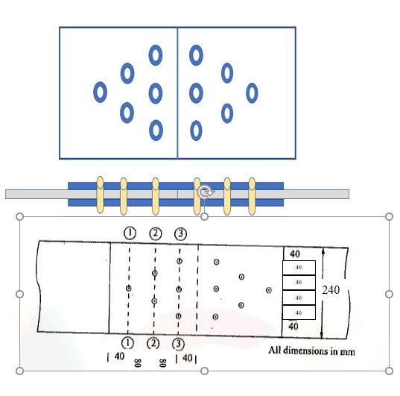
Q. 2 Determine the ultimate load carrying capacity in tension of double cover butt joint the plate of size 240*14 mm shown in fig. and cover plate thickness is 7 mm. Use M18 bolts of product grade C and property class 4.6. The yield and ultimate strengths of the plats are 250 MPa and 410MPa, respectively.
Bolt dia. =18 mm
The diameter of the hole = 18 + 2 = 20 mm
Min. Edge distance =1.7*d_{o} = 1.7*20 = 34 mm
Max. edge = 12te = 12*14*(250/400)^{0.5} = 132.81 mm
edge provided = 1st case 45 mm ( 2nd case 35) (3rd case 40mm) (4th case 40mm)
Min. pitch = 2.5 d = 2.5*18 = 45 mm
Max. pitch =32*14 or 300 = 448 /300 mm = 300mm
Pitch provide is= 1st case 45 mm (2nd case 45mm ) ( 3rd case 55mm) (4th case 50mm)
Since property class of bolt is 4.6, f_{ub} = 400 MPa
The design strength of the plate due to rupture at the net section,
T_{dn} = 0.9 An f_{u}/ g _{m1}
= 0.9 {(250 -1*20) *14}* 410/1.25
= 950.5 KN
Yield strength of plate is = 240*14*250/1.1 = 763.6 KN
V_{nsb} = f_{ub}/sqrt3(n_{n}A_{nb}+ n_{s}A_{sb})= 400/sqrt3(2*192+0*255) = 266.04 KN
The design shear strength of the bolt,
Vdsb = Vnsb / g mb = 266.04/1.25 = 212.8 KN

Slide 10
1st case , 45/3*20,(60/3*20-.25),400/410,1 =0.75, .75, .97,1 so kb = 0.75
V_{npb} = 2.5 k_{b} dt f_{u} = 2.5*0.75*18*14*410 = 193.72 KN
The design bearing strength of the bolt, V_{dpb} = V_{npb} / g _{mb} = 193.72/1.25 = 154.97 KN
Bolt value = (Least value of V_{dsb} and V_{dpb})
= (Least value of 212.8 and 154.97)
= 154.97 KN
The design strength of the connection in the shear or bearing
6*154.97 = 929.82 KN > 763.6KN
Strength of plate is 763.6KN

Slide 11
2nd case, 35/3*20,(45/3*20-.25),400/410,1 =0.58, .5, .97,1 so kb = 0.5
3rd case, 40/3*20,(55/3*20-.25),400/410,1 =0.67, .67, .97,1 so kb = 0.67
4th case, 40/3*20,(50/3*20-.25),400/410,1 =0.67, .58, .97,1 so kb = 0.58
2nd V_{npb} = 2.5 k_{b} dt f_{u} = 2.5*0.5*18*14*410 = 129.150 KN V_{dpb=} 103.32 KN
3rd V_{npb} = 2.5 k_{b} dt f_{u} = 2.5*0.67*18*14*410 = 173.06KN V_{dpb=} 138.48 KN
4th V_{npb} = 2.5 k_{b} dt f_{u} = 2.5*0.58*18*14*410 = 173.06KN V_{dpb=} 119.87 KN
The design bearing strength of the bolt, V_{dpb} = V_{npb} / g _{mb} = 103.32 and 138.48 KN and 119.87 KN
Bolt value = (Least value of V_{dsb} and V_{dpb})
= (Least value of 212.8 and 103.32) or (212.8 and 138.48KN) or (212.8 and 119.87 KN)
= 103.32 KN/ 138.44KN/ 119.87 KN
The design strength of the connection in the shear or bearing
6*103.32 or 6*138.44 or 6*119.87 = 619.92 KN / 830.64 KN/ 719.22 KN
expected strength of plate is 763.6KN

Slide 12
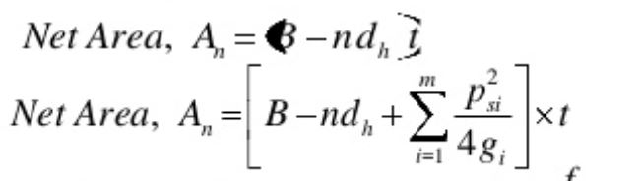
4
Net strength for 1-1 section = 0.9 (240-20)*14 *400/ 1.25 = 887.04 KN > 763.6 OK
Net strength for 2-2 section = 0.9 (240-2*20)*14 *400/ 1.25 = 806.4 KN > 5/6* 763.6 ok
Net strength for 3-3 section = 0.9 (240-3*20)*14 *400/ 1.25 = 725.76 KN> 3/6*763.6 Ok
Net strength for 4-4 section = 0.9 (240-5*20+4*55²/(4*40))*14 *400/ 1.25 = 869.4 KN > 763.6KN ok
check for cover plate
Net strength for 3-3 section = 0.9 (240-3*20)*14 *400/ 1.25 = 725.76 < 763.6 not Ok
Calculate thickness required = 763.6*1000/(0.9 (240-3*20)*400/ 1.25 ) = 14.7mm
Provide 8mm plate at top and bottom of the plate
Net strength of plate if 8mm plate provided = .9*(240-3*20)*16*400/1.25= 829.26> 763.6KN OK
Strength of connection plate is = 763.6KN
Connection efficiency is 100%
Because the max. strength is either yield strength or 1 bolt reduction rupture strength
4

Slide 13
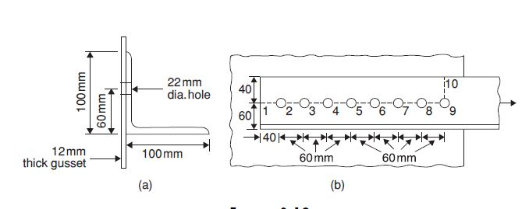

Qsn. 3
Find the ultimate design strength of angle 100 100 × 10 in tension which is connected to a gusset 12 mm thick through 100 mm leg using M20 bolts of property class 4.6 in a single line. Assume that the bolt threads are outside the shear plane. The yield and the ultimate strengths of the steel are 250MPa and 410MPa, respectively.
Solution.
The diameter of the hole for M20 bolt = 20 + 2 = 22 mm
Min. Edge distance =1.7*d_{o} = 37.4 mm
Max. edge = 12te or 12*12*(250/400)^{0.5} = 113.8mm
edge provided = 40 mm
Min. pitch = 2.5*22= 55 mm
Max. pitch =16*12 or 200 = 192mm
Pitch provide is 60 mm
The gross sectional of angle, Ag = 1,900 mm2
The design strength of the angle due to yielding, T_{dg} = Ag f_{y} / g _{m0} = 1,900 * 250/1.1 = 431.8KN
Design of the end connection
40/3*22, (60/3*22-.25),400/410, 1 = 0.60, 0.65, 0.97,1 = 0.60 , K_{b}= 0.606
V_{nsb} = f_{ub}/sqrt3(n_{n}A_{nb}+ n_{s}A_{sb})= 400/sqrt3(1*245+0*314) = 56.58KN
V_{dsb} = 56.58/1.25 = 45.26 KN

Slide 14
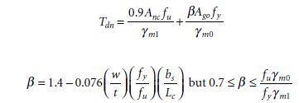
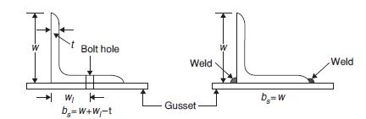
w = width of the outstanding leg
bs = shear lag width
Lc = length of the end connection,
i.e., distance between the outermost bolts or length of
the weld along the direction of load
Vnpb = 2.5 kb dtfu = 2.5*0.606*20 *10*410 = 124.23KN
Vdpb = 124.23/1.25 = 99.384 KN
Number of bolts = 431.81/45.26 = 9.55
10 bolts may be provided
Design strength due to rapture is
b_{s} = 60+100-10 = 150mm
L_{c} = 9*60 = 540mm
b = 1.4 - 0.076(100/10)(250/410)(150/540) = 1.27
T_{dn =} {0.9*(100-5-20)*10*410}/1.25 +{(1.27*(100-5)*10*250)}/1.1
= 495.60 KN
For ∠ 100 100 × 10 , T_{dn} = 495.60KN

Slide 15
Design strength due to the block shear
Avg = 540 *10 = 5400 mm² (along 1-9 )
Avn = (580 -9.5 *20)*10 = 3900 mm² (along 1-9 )
Atg = 40 *10 = 400 mm2 (along 9-10)
Atn = (40 -0.5*20) *10 = 290 mm (along 9-10)
T_{bd =} 5400*250/1.1*sqrt3 + 0.9*290*410/1.25 or 0.9*3900*410/1.25*sqrt3 + 400*250/1.1
794.17 KN or 755.60 KN
T_{bd} = 755.60 KN
The ultimate design strength of angle 100 100 *10 = Least of 431.818 KN, 495.60 KN, 755.60 KN
= 431.818 KN

Slide 16
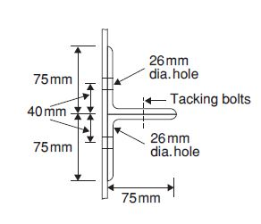
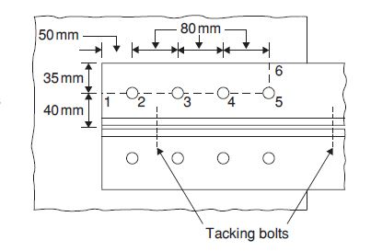
Qsn 4.
Find the ultimate load carrying capacity in the following cases:
(1) 2 ∠ 75 75 × 12 connected to the same side of the gusset,
Assume that in either case tacking bolts are provided and the end connection is done using M24 bolts of property class 4.6. The yield and ultimate strengths of the steel are 250 MPa and 410 MPa, respectively.
Solution.
Diameter of the bolt hole = 24 + 2 = 26 mm
Min. Edge distance =1.7*d_{o} = 44.2mm
Max. edge = 12te or 12*12*(250/400)^{0.5} = 113.8mm
edge provided = 50 mm
Min. pitch = 2.5*24= 60 mm
Max. pitch =16*12 or 200 = 192mm
Pitch provide is 80mm
Gross area of the cross section of each angle = 1,680 mm2
Design strength of the angles due to yielding, T_{dg} = 2*1680*(250/1.1) = 763.63 KN
Case (i) 2 ∠ 75 75 × 12 connected to the same side of the gusset
Design of the end connection
V_{nsb} = (400/sqrt3)*1*353 = 81.52 KN
(for shear plane within bolt threads)
V_{dsb} = 81.52 /1.25 = 65.21 KN
K_{b} is least of (50/3*26), (80/3*26-.25), 400/410, 1= 0.64, 0.77, 0.97,1 is = 0.64

Slide 17
Vnpb = 2.5 × 0.64 × 24 × 10 × 410 = 157.44 KN
Vdpb = 157.44/1.25 = 125.9 KN
Number of bolts = 763.63/65.21 = 11.71 so 12 bolt
6 bolts in each angle may be provided
Design strength due to rupture
bs = 40 + 75 − 12 = 103 mm
Length of the connection, Lc = 5 × 80 = 400 mm
b = 1.4 - .0076(75/12)(250/410)(103/400) = 0.765
T_{dn =} {0.9*(75-5-26)*12*410}/1.25 +{(.765*(75-5)*12*250)}/1.1 = 301.911 KN
For 2 ∠ 75 75 × 12 , T_{dn} = 2 × 301.911 = 603.82 KN
Design strength due to block shear
A_{vg} = 450 × 12 = 5400 mm² (along 1-5 )
A_{vn} = (450 − 5.5 × 26) × 12 = 3684 mm² (along 1-5)
A_{tg} = 35 × 12 = 420 mm² (along 5-6)
A_{tn} = (35 − 0.5 × 26) × 12 = 264 mm² (along 5-6 )
T_{bd} = 5400*250/(1.1*sqrt3) + 0.9*264*410/1.25
or
0.9*3684*410/(1.25*sqrt3) + 420*250/1.1
786.49 KN or 723.33 KN
T_{bd =} 723.33 KN
For 2 ∠ 75 75 × 10, T_{bd} = 2 × 723.33 = 1446.66 KN
The ultimate load carrying capacity of 2 ∠ 75 75 × 12
= least of 763.63 KN, 603.82 KN, 1221.69 KN
= 603.82 KN
w = width of the outstanding leg
bs = shear lag width
Lc = length of the end connection,
i.e., distance between the outermost bolts or length of
the weld along the direction of load

Slide 18
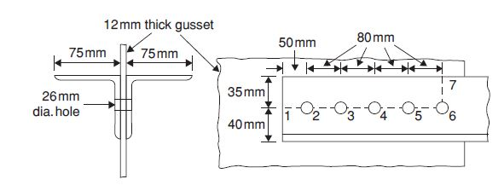
Qsn 4. B)
Find the ultimate load carrying capacity in the following cases:
(1) 2 ∠ 75 75 × 12 connected to both sides of the gusset plate,
Assume that in either case tacking bolts are provided and the end connection is done using M24 bolts of property class 4.6. The yield and ultimate strengths of the steel are 250 MPa and 410 MPa, respectively and thickness of gusset plate is 12mm.
Solution.
Diameter of the bolt hole = 24 + 2 = 26 mm
Min. Edge distance =1.7*d_{o} = 44.2mm
Max. edge = 12te or 12*12*(250/400)^{0.5} = 113.8mm
edge provided = 50 mm
Min. pitch = 2.5*24= 60 mm
Max. pitch =16*12 or 200 = 192mm
Pitch provide is 80mm
Gross area of the cross section of each angle = 1,680 mm²
Design strength of the angles due to yielding, T_{dg} = 2*1680*(250/1.1) = 763.63 KN
Case (i) 2 ∠ 75 75 × 12 connected to both sides of the gusset plate
V_{nsb} = (400/sqrt3)*2*353 = 163.04 KN
(for shear plane within bolt threads)
V_{dsb} = 163.04 /1.25 = 130.43 KN
K_{b} is least of (50/3*26), (80/3*26-.25), 400/410, 1= 0.64, 0.77, 0.97,1 is = 0.64

Slide 19
Vnpb = 2.5 × 0.64 × 24 × 12 × 410 = 188.92 KN
Vdpb = 188.92 /1.25 = 151.14 KN
Number of bolts = 763.63 / 130.43 = 5.85 = 6 bolt
6 bolts may be provided as shown in Figure
Design strength due to rupture
Length of the connection, Lc = 5 × 80 = 400 mm
b = 1.4 - .0076(75/12)(250/410)(103/400) = 0.765
T_{dn =} {0.9*(75-5-26)*12*410}/1.25 +{(.765*(75-5)*12*250)}/1.1 = 301.911 KN
For 2 ∠ 75 75 × 12 , T_{dn} = 2 × 301.911 = 603.82 KN
Design strength due to the block shear
A_{vg} = 450 × 12 = 5400 mm² (along 1-6)
A_{vn} = (450 − 5.5 × 26) × 12 = 3684 mm² (along 1-6)
A_{tg} = 35 × 12 = 420 mm² (along 6-7)
A_{tn} = (35 − 0.5 × 26) × 12 = 264 mm² (along 6-7)
T_{bd} = 5400*250/(1.1*sqrt3) + 0.9*264*410/1.25
or
0.9*3684*410/(1.25*sqrt3) + 420*250/1.1
786.49 KN or 723.33 KN
T_{bd =} 723.33 KN
For 2 ∠ 75 75 × 10, T_{bd} = 2 × 723.33 = 1446.66 KN
The ultimate load carrying capacity of connection is
= least of 763.63 KN, 603.82 KN, 1446.66 KN
= 603.82 KN

Slide 20
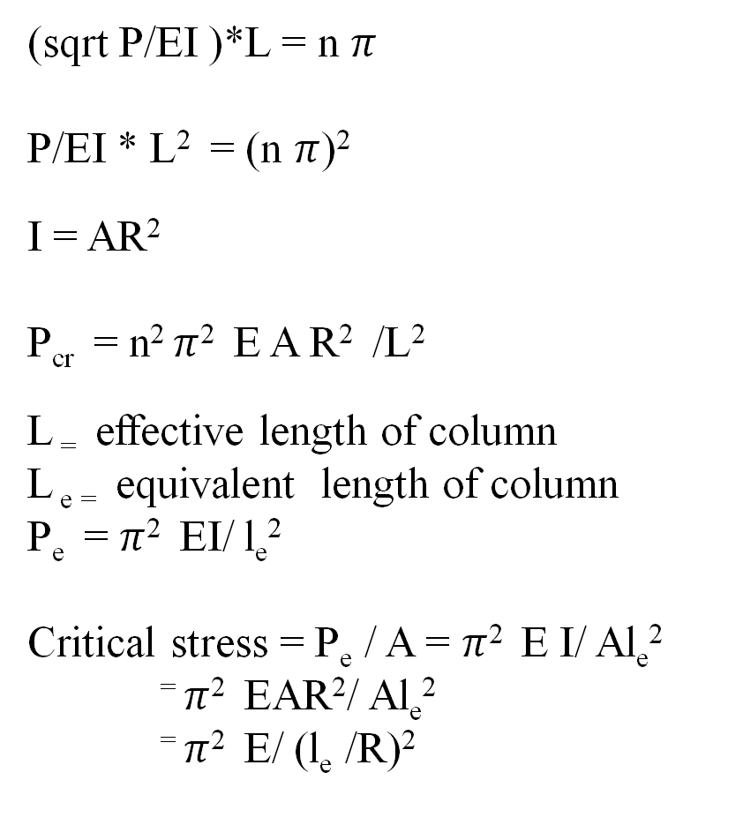
(sqrt P/EI )*L = n $π$
P/EI * L² = (n $π$)²
I = AR²
P_{cr} = n² $π$² E A R² /L²
L ₌ effective length of column
L _{e =} equivalent length of column
P_{e} = $π$² EI/ l_{e}²
Critical stress = P_{e} / A = $π$² E I/ Al_{e}²
⁼ $π$² EAR²/ Al_{e}²
⁼ $π$² E/ (l_{e} /R)²

Slide 21
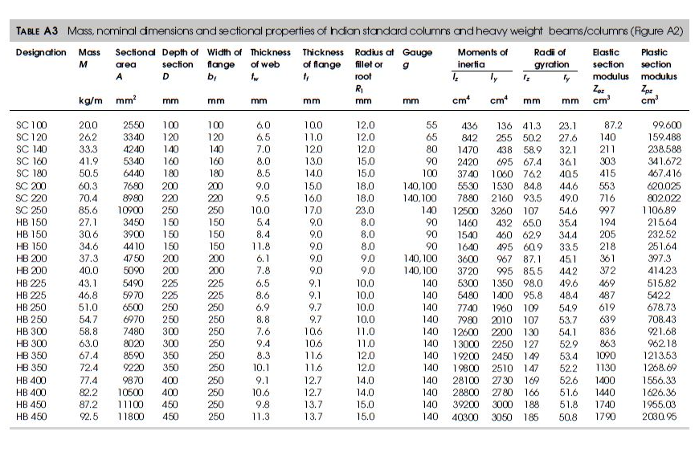

Slide 22
y
SC 200 I section
Area 7680mm2
I_{zz} = 5530cm⁴ R_{zz} = root(5530*10000/7680)= 84.8mm
I_{yy} = 1530cm⁴ R_{yy} = sqrt(1530*10000/7680) = 44.6mm
L = 3.5m
If end pined both side
Effictive length is 3.5m
Sr. ratio = Max. of (3.5*1000/84.4) or (3.5*1000/44.6) is 78.47
Allowable stress
For 80 stress is 136 and
For 70 stress is 152 for class C buckling
For f_{cd} = 152-(152-136)*(78.4-70)/10 = 138.45mpa
h/b_{f} is 200/200 = 1
Length of column is vertical Hight of column
z
z
y

Slide 23
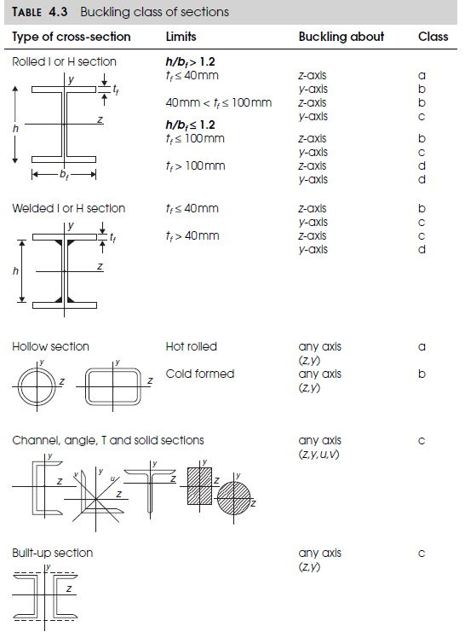
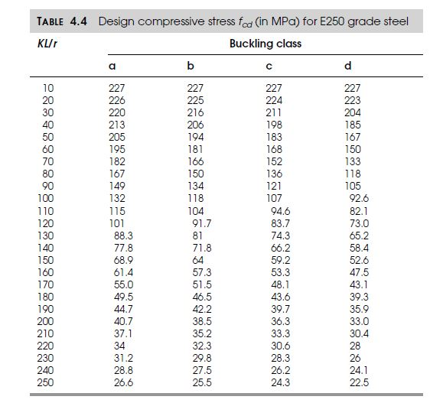

Slide 24
y
SC 200 I section
Area 7680mm2
I_{zz} = 5530cm⁴ R_{zz} = root(5530*10000/7680)= 84.8mm
I_{yy} = 1530cm⁴ R_{yy} = sqrt(1530*10000/7680) = 44.6mm
L = 3.5m
If end pined both side
Effictive length is 3.5m
Sr. ratio = Max. of (3.5*1000/84.4) or (3.5*1000/44.6) is 78.47
Allowable stress
For 80 stress is 136 and
For 70 stress is 152 for class C buckling
For f_{cd} = 152-(152-136)*(78.4-70)/10 = 138.45mpa
h/b_{f} is 200/200 = 1
Length of column is vertical Hight of column
z
z
y

Slide 25
Design a simple column of 5.5m to carry an working axial live load of in 400 kN which have unsupported length is 5.5meter, with boundary condition as mentioned. (use steel Fe410 and yield stress fy = 250 MPa)
The effective length of the column in both planes will be 5.5 m
For Fe 410, fu = 410 N/mm2, fy = 250N/mm2
For preliminary design, let design compressive stress, fcd = 160N/mm2
Cross section area required A = P/ fcd, where P = 1.5*400 kN, so Area required is = 600*1000/160 = 3750 N/mm2
Select section of Try ISMB 225@31.2kg/m
Area = 3972 mm² > 3750mm² ok
r_{z} = 93.31 mm
r_{y} = 23.4 mm
H=225 mm, b_{f} = 110 mm ( h/b_{f} = 200/110 = 1.818 > 1.2)
T_{f} = 11.8 mm < 100 mm
Therefore, the buckling class of the section will be,
Class A for Z axis and Class B for Y axis
Case 1 : Both ends pinned
Slenderness ratio, KL_{z}/r_{z} = 1*5.5*1000/93.31 = 58.94
From Table 4.4, buckling class b for Z axis
for 60, f_{cd} = 195 Mpa and for 50, f_{cd} = 205 Mpa
So, f_{cd} = 205 – (205-195)*(58.94-50)/10 = 196.06 Mpa
Load caring capacity for selected section is = f_{cd} * A = 196.06*3750 = 735.22 KN > 600KN ok , but design is over safe and uneconomical select lower area section and redesign
y
z
z
y

Slide 26
Case 2 : One end fixed and other end pinned
Slenderness ratio, KL_{z}/r_{z} = 0.707*5.5*1000/93.31 = 41.67
From Table 4.4, buckling class b for Z axis
for 40, f_{cd} = 213 Mpa and for 50, f_{cd} = 205 Mpa
So, f_{cd} = 213 – (213-205)*(41.67-40)/10 = 211.66 Mpa
Load caring capacity for selected section is = f_{cd} * A = 211.66*3750 = 793.73 KN > 600KN ok
but design is over safe and uneconomical select lower area section and redesign
Case 3 : Both ends fixed
Slenderness ratio, KL_{z}/r_{z} = 0.5*5.5*1000/93.31 = 29.47
From Table 4.4, buckling class b for Z axis
for 20, f_{cd} = 226 Mpa and for 30, f_{cd} = 220 Mpa
So, f_{cd} = 226 – (226-220)*(29.47-20)/10 = 220.31 Mpa
Load caring capacity for selected section is = f_{cd} * A = 220.31*3750 = 826.188 KN > 600KN ok
but design is over safe and uneconomical select lower area section and redesign
Case 4 : one end fixed and other end free
Slenderness ratio, KL_{z}/r_{z} = 2*5.5*1000/93.31 = 117.88
From Table 4.4, buckling class b for Z axis
for 120, f_{cd} = 101 Mpa and for 110, f_{cd} = 115 Mpa
So, f_{cd} = 115 – (115-101)*(117.88-110)/10 = 103.95 Mpa
Load caring capacity for selected section is = f_{cd} * A = 103.95*3750 = 389.84 KN < 600KN Failed
Redesign taking another section having higher area

Slide 27
The length of the column in both planes is 3.5 m
SC 200 is used as a column,
Area = 7680 mm²
I_{z} = 5530 cm⁴ and I_{y} = 1530 cm⁴
r_{z} = (5530*10000/7680)^{0.5} mm = 84.8 mm
r_{y} = (1530*10000/7680)^{0.5} mm = 44.6 mm
H=200 mm, b_{f} = 200mm ( h/b_{f} = 1 < 1.2)
T_{f} = 15 mm < 100 mm
Therefore, the buckling class of the section will be, ( from Table 4.3)
Class b for Z axis and Class c for Y axis
y
z
z
Case 1 : Both ends pinned
The effective length of the column in both planes will be 3.5 m and k = 1
Slenderness ratio, KL_{z}/r_{z} = 3.5*1000/84.8 = 41.27
From Table 4.4, buckling class b for Z axis
for 40, f_{cd} = 206 Mpa and for 50, f_{cd} = 194 Mpa
So, f_{cd} = 206 – (206-194)*(41.27-40)/10 = 204.476 Mpa
y

Slide 28
Slenderness ratio , KL_{z}/r_{z} = 3.5*1000/44.6 = 78.47
From Table 4.4, buckling class c for Y axis
for 70, f_{cd} = 152 Mpa and for 80, f_{cd} = 136 Mpa
So, f_{cd} = 152– (152-136)*(78.47-70)/10 = 138.448 Mpa
The minimum of the two is 138.448 N/mm²
Therefore, the design load carrying capacity = 7680*138.448 = 1063.28 kN
Case 2 : One end fixed, and another end pinned
The effective length of the column in both planes will be 0.8*3.5 m = 2.8 m
Slenderness ratio, KL_{z}/r_{z} = 2.8*1000/84.8 = 33.01
From Table 4.4, buckling class b for Z axis
for 20, f_{cd} = 225 Mpa and for 30, f_{cd} = 216 Mpa
So, f_{cd} = 225 – (225-216)*(29.18-20)/10 = 216.738 Mpa
Slenderness ratio , KL_{z}/r_{z} = 2.4745*1000/44.6 = 55.48
From Table 4.4, buckling class c for Y axis
for 50, f_{cd} = 183 Mpa and for 60, f_{cd} = 168 Mpa
So, f_{cd} = 183– (183-168)*(55.48-50)/10 = 174.78 Mpa
The minimum of the two is 174.78 N/mm²
Therefore, the design load carrying capacity = 7680*174.78 = 1342.31 kN

Slide 29
Case 3 : Both ends fixed
The effective length of the column in both planes will be 0.5*3.5 m = 1.75 m
Slenderness ratio, KL_{z}/r_{z} = 1.75*1000/84.8 = 20.64
From Table 4.4, buckling class b for Z axis
for 20, f_{cd} = 225 Mpa and for 30, f_{cd} = 216 Mpa
So, f_{cd} = 225 – (225-216)*(20.64-20)/10 = 224.424 Mpa
Slenderness ratio , KL_{z}/r_{z} = 1.75*1000/44.6 = 39.24
From Table 4.4, buckling class c for Y axis
for 30, f_{cd} = 211 Mpa and for 40, f_{cd} = 198 Mpa
So, f_{cd} = 211– (211-198)*(39.24-30)/10 = 198.988 Mpa
The minimum of the two is 198.988 N/mm²
Therefore, the design load carrying capacity = 7680*198.988 = 1528.23 kN
Case 4 : one end fixed and other end free
The effective length of the column in both planes will be 2*3.5 m = 7 m
Slenderness ratio, KL_{z}/r_{z} = 7*1000/84.8 = 82.55
From Table 4.4, buckling class b for Z axis
for 80, f_{cd} = 150 Mpa and for 90, f_{cd} = 134 Mpa
So, f_{cd} = 150 – (150-134)*(82.55-80)/10 = 145.92 Mpa

Slide 30
Slenderness ratio , KL_{z}/r_{z} = 7*1000/44.6 = 156.95
From Table 4.4, buckling class c for Y axis
for 150, f_{cd} = 59.2 Mpa and for 160, f_{cd} = 53.3 Mpa
So, f_{cd} = 59.2– (59.2-53.3)*(156.95-150)/10 = 55.0995 Mpa
The minimum of the two is 55.0995 N/mm²
Therefore, the design load carrying capacity = 7680*55.0995 = 423.164 kN
55
138
174
198

Slide 31
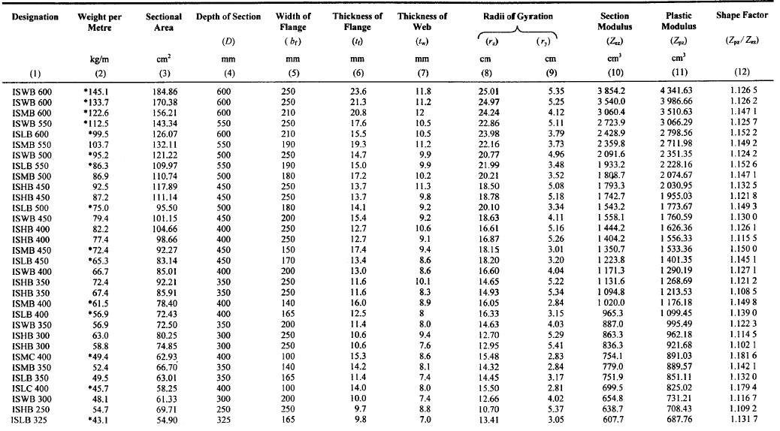

Slide 32
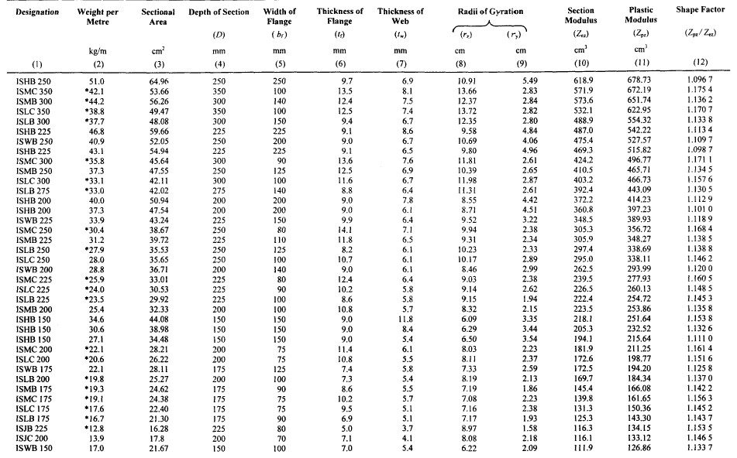

Slide 33
Design of lacing, Battering and Column bases
Codal Requirement
IS 800:2007 Steel table
Example 1 Design a build up column to carry a factored axial load of 1000kN which is 8.5m long hinged at both ends. Design the associated lacing system also. Use steel of grade Fe410 and bolts of grade 4.6. only available section is channel section. Explain all possible arrangement of channel section.
Solution : Design load is 666.66KN , factored load = 1.5*666.66 = 1000KN
For Fe 410, f_{u} = 410 N/mm², f_{y =} 250N/mm²
Let bolts of grade 4.6 are used and thus f_{ub=}400N/mm²
Factor od safety for angle material ¥_{mo} = 1.10
Factor od safety for angle material ¥_{mb} = 1.25
For preliminary design, let design compressive stress, f_{cd}=150N/mm²
Cross section area required A=P/ f_{cd, where} P = 1000kN
= 1000*1000/150 = 6666.66mm²

Slide 34
Designati on | Weight per Mete (w) | Sectional Area (a) | Depth of Section (h) | Width of flange (b) | Thickness of Flange (t_{f}) | Thicknes s of Web (t_{w}) | Centre of Gravity Cyy | Ixx cm4 | Iyy cm4 | Raddi of Gyration rxx | Raddi of Gyration ryy | Modulli of Section Zxx | Modulli of Section Zyy | Connection Details |  |  |  |  |  | Maximum size of Flange Rivet | Designati on
 | kg | cm² | mm | mm | mm | mm | cm |  |  | cm | cm | cm³ | cm³ | h₁ | h2 | b1/2 | C | g | g₁ | mm
 |  |  |  |  |  |  |  |  |  |  |  |  |  | mm | mm | mm | mm | mm | (min) mm
ISMC 75 | 6.8 | 8.67 | 75 | 40 | 7.3 | 4.4 | 1.31 | 76 | 12.6 | 2.96 | 1.21 | 20.3 | 4.7 | 41.4 | 16.8 | 17.8 | 5.9 | 21 | 50 | 12 | ISMC 75
ISMC 100 | 9.2 | 11.7 | 100 | 50 | 7.5 | 4.7 | 1.53 | 186.7 | 25.9 | 4 | 1.49 | 37.3 | 7.5 | 64 | 18 | 22.7 | 6.2 | 28 | 50 | 16 | ISMC 100
ISMC 125 | 12.7 | 16.19 | 125 | 65 | 8.1 | 5 | 1.94 | 416.4 | 59.9 | 5.07 | 1.92 | 66.6 | 13.1 | 85.4 | 19.8 | 30 | 6.5 | 35 | 55 | 22 | ISMC 125
ISMC 150 | 16.4 | 20.88 | 150 | 75 | 9 | 5.4 | 2.22 | 779.4 | 102.3 | 6.11 | 2.21 | 103.9 | 19.4 | 106.7 | 21.7 | 34.8 | 6.9 | 40 | 55 | 25 | ISMC 150
ISMC 175 | 19.1 | 24.38 | 175 | 75 | 10.2 | 5.7 | 2.2 | 1223.3 | 121 | 7.08 | 2.23 | 139.8 | 22.8 | 128.4 | 23.3 | 34.7 | 7.2 | 40 | 55 | 25 | ISMC 175
ISMC 200 | 22.1 | 28.21 | 200 | 75 | 11.4 | 6.1 | 2.17 | 1819.3 | 140.4 | 8.03 | 2.23 | 181.9 | 26.3 | 150.2 | 24.9 | 34.5 | 7.6 | 40 | 60 | 25 | ISMC 200
ISMC 225 | 25.9 | 33.01 | 225 | 80 | 12.4 | 6.4 | 2.3 | 2694.6 | 187.2 | 9.03 | 2.38 | 239.5 | 32.8 | 170.9 | 27.1 | 36.8 | 7.9 | 45 | 60 | 25 | ISMC 225
ISMC 250 | 30.4 | 38.67 | 250 | 80 | 14.1 | 7.1 | 2.3 | 3816.8 | 219.1 | 9.94 | 2.38 | 305.3 | 38.4 | 192.5 | 28.7 | 36.5 | 8.6 | 45 | 65 | 25 | ISMC 250
ISMC 300 | 35.8 | 45.64 | 300 | 90 | 13.6 | 7.6 | 2.36 | 6362.8 | 310.8 | 11.81 | 2.61 | 424.2 | 46.8 | 240.7 | 29.6 | 41.2 | 9.1 | 50 | 65 | 28 | ISMC 300
ISMC 350 | 42.1 | 53.66 | 350 | 100 | 13.5 | 8.1 | 2.44 | 10008 | 430.6 | 13.66 | 2.83 | 571.9 | 51 | 288.1 | 30.9 | 46 | 9.6 | 60 | 65 | 28 | ISMC 350
ISMC 400 | 49.4 | 62.93 | 400 | 100 | 15.3 | 8.6 | 2.42 | 15082.8 | 504.8 | 15.48 | 2.83 | 754.1 | 66.6 | 332.8 | 33.6 | 45.7 | 10.1 | 60 | 70 | 28 | ISMC 400
Try ISMC 250@298.2N/m
Thus, area provided by 2 ISMC 250 = 2*3867 = 7734mm² > 6666.67mm²

Slide 35
The advantage of build up column is that least radius of gyration can be increased so that is lest radios of gyration can be made more at least equal to r_{zz} i.e.
rmin =rzz this is done by adjusting spacing between the sections.
Effective length = kL = 1*8.5 = 8.5m
For effective slenderness ratio
(kL/r) _{e} = 89.79 and f_{y} 250N/mm² and for buckling curve “C”
Design compressive stress (f_{cd}) = 121.315N/mm²
Design compressive strength (P_{cd}) = f_{cd*}A = 121.315*(2*3867) N = 938.250KN
938.25kN < 1000kN
Now minimum radius of gyration (ʎ_{min}) = r_{z} | = 99.4mm
Slenderness ration ʎ = kL/ r_{z} = 8500/99.4 | = 85.513
Effective slenderness ratio (ʎ_{e}) = 1.05*85.513 | = 89.89 < 180 …. Ok
ISMC 250@298.2N/m | is ……………………………………………………………. | Not safe

Slide 36
Buckling class C table for f_{cd} value
Thus, Try ISMC 300@351.2N/mm²
For effective slenderness ratio
(kL/r)_{e} = 75.57 and f_{y} 250N/mm² and for buckling curve “C”
Design compressive stress (f_{cd}) = 143.09N/mm²
Design compressive strength (P_{cd}) = f_{cd*}A = 143.09*(2*4564) N =
1306.13kN < 1000kN … ok
Thus, ISMC 300@351.2N/mm² is safe
kL/r | 10 | 20 | 30 | 40 | 50 | 60 | 70 | 80 | 90 | 100 | 110 | 120 | 130 | 140 | 150 | 160 | 170 | 180 | 190 | 200 | 210 | 220 | 230 | 240 | 250
F_{cd} | 227 | 224 | 211 | 198 | 183 | 168 | 152 | 136 | 121 | 107 | 94.6 | 83.7 | 74.3 | 66.2 | 59.2 | 53.3 | 48.1 | 43.6 | 39.7 | 36.3 | 33.3 | 30.6 | 28.3 | 26.2 | 24.3
f | 0.3 | 1.3 | 1.3 | 1.5 | 1.5 | 1.6 | 1.6 | 1.5 | 1.4 | 1.24 | 1.09 | 0.94 | 0.81 | 0.7 | 0.59 | 0.52 | 0.45 | 0.39 | 0.34 | 0.3 | 0.27 | 0.24 | 0.21 | 0.19
area provided by 2 ISMC = 2*4564 | = 9128mm² > 6666.67mm²
Now minimum radius of gyration (ʎ_{min}) | = r_{z} = 118.10mm
Slenderness ration ʎ = kL/ r_{z} | = 8500/118.1 = 71.97
Effective slenderness ratio (ʎ_{e}) | = 1.05*71.97 = 75.57 < 180 …. Ok

Slide 37
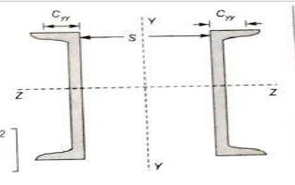
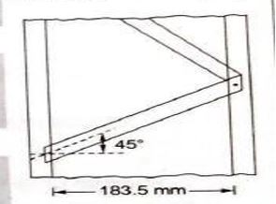
A) Arrangement 1 – Channels are placed back to back
The channels are so spaced that
M.O.I. _{z} = M.O.I. _{y}
2I_{z} = 2(I_{y} + A(S/2 + C_{yy})^2)
2*6262.6*10000 = 2(310.8*10000 + 4564 (S/2 + 23.6)²)
S = 183.103 mm = 183.5 mm
Thus place channels back to back at a spacing of 183.5 mm
Design of lacings
Let lacing are inclined at 45 deg with the horizontal
Thus length of channel between lacings = (183.5 +50+50)cot45 * 2 = 567 mm
Therefore, Slenderness ratio of portion of channel between lacings
= 567/r_{y} = 567/26.1 = 21.724 < 50 (OK)
Also, 0.7 (kL/r)_{e} = 0.7 x 75.57 = 52.899 > 21.724 (OK)
Design shear for lacing (V0 = 2.5% of axial load = 2.5/100 x 1000 = 25 KN
Therefore, shear in each plane = V/N = 2.5/2 = 12.5 KN
Therefore, compressive force in the lacing bars = (V/N) *cosec (45) = 17.68 KN

Slide 38
Section of lacing flat
Using 16 mm diameter bolts, minimum width of lacing flat required = 3 x 16 = 48 mm = 55 mm
Thus minimum thickness of lacing flat
= 1/40 ( Distance between the inner end bolts)
= 1/40 ( 183.5 + 50 +50)cosec 45
= 10.02 mm = 12 mm
Therefore provide lacing flat of size 55 x 12 mm( 55 ISF 12mm)
Minimum radius of gyration,
R = t/sqrt(12) = 12/sqrt(12) = 3.464
Slenderness ratio, L/r = 283.5 cosec 45/3.464 = 115.74 < 145
For l/r = 115.74, f_{y} = 250 N/mm² and for buckling curve c
Design compressive stress (f_{cd}) = 88.34 N/mm²
Therefore, Design compressive strength (P_{cd}) = f_{cd} x A
= 88.34 x (55 x 12) N
= 58.3 KN (>17.68 KN)

Slide 39
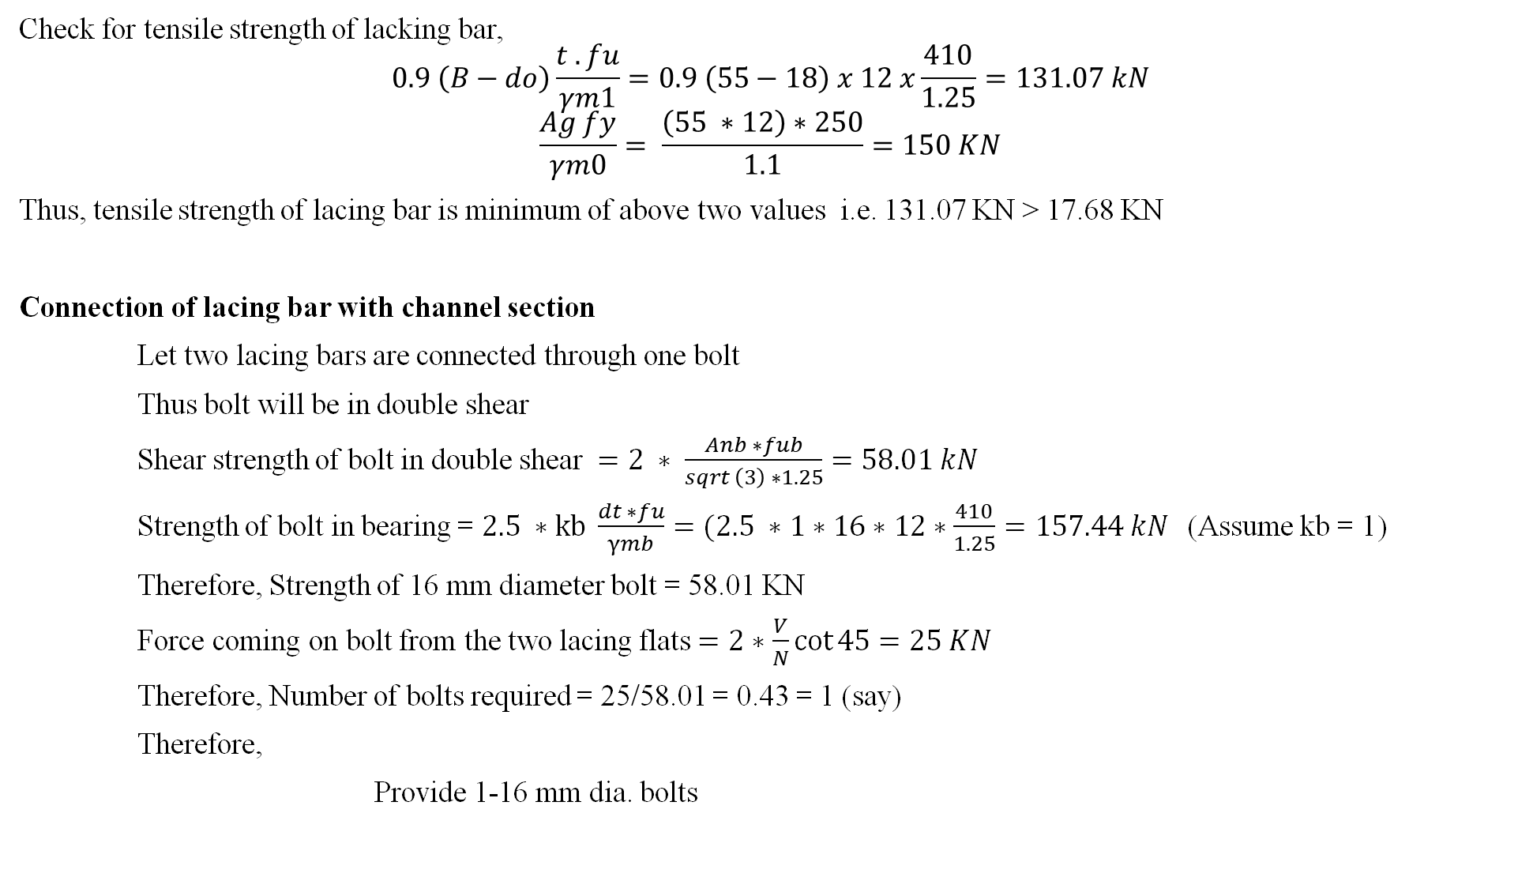
Check for tensile strength of lacking bar,
$$0.9 \left(B−do\right)\frac{t . fu}{γm1}=0.9 \left(55−18\right) x 12 x\frac{410}{1.25}=131.07 kN$$
$$\frac{Ag fy}{γm0}= \frac{\left(55 ∗12\right)∗250}{1.1}=150 KN$$
Thus, tensile strength of lacing bar is minimum of above two values i.e. 131.07 KN > 17.68 KN
Connection of lacing bar with channel section
Let two lacing bars are connected through one bolt
Thus bolt will be in double shear
Shear strength of bolt in double shear $=2 ∗ \frac{Anb ∗fub}{sqrt \left(3\right) ∗1.25}=58.01 kN$
Strength of bolt in bearing = $2.5 ∗kb \frac{dt ∗fu}{γmb}=(2.5 ∗1∗16∗12∗\frac{410}{1.25}=157.44 kN$(Assume kb = 1)
Therefore, Strength of 16 mm diameter bolt = 58.01 KN
Force coming on bolt from the two lacing flats $=2∗\frac{V}{N}\cot{45}=25 KN$
Therefore, Number of bolts required = 25/58.01 = 0.43 = 1 (say)
Therefore,
Provide 1-16 mm dia. bolts

Slide 40
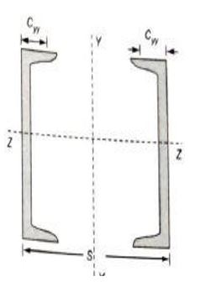
B) Arrangement 2 – Channels are placed face to face
The channels are so spaced that
M.O.I._{z} = M.O.I._{y}
2I_{z} = 2(I_{y} + A(S/2 - C_{yy})²)
2*6262.6*10000 = 2(310.8*10000 + 4564 (S/2 - 23.6)²)
S = 277.5 mm = 278 mm
Thus place channels face to face at a spacing of 278 mm
Design of lacings
Let lacing are inclined at 45 deg with the horizontal
Thus length of channel between lacings = (278 – 50 - 50)cot45 * 2 = 356 mm
Therefore, Slenderness ratio of portion of channel between lacings
= 356/r_{y} = 356/26.1 = 13.64 < 50 (OK)
Also, 0.7 (kL/r)_{e} = 0.7 x 75.57 = 52.899 > 21.724 (OK)
Design shear for lacing (V₀ = 2.5% of axial load = 2.5/100 x 1000 = 25 KN
Therefore, shear in each plane = V/N = 2.5/2 = 12.5 KN
Therefore, compressive force in the lacing bars = V cosec (45)/N = 17.68 KN

Slide 41
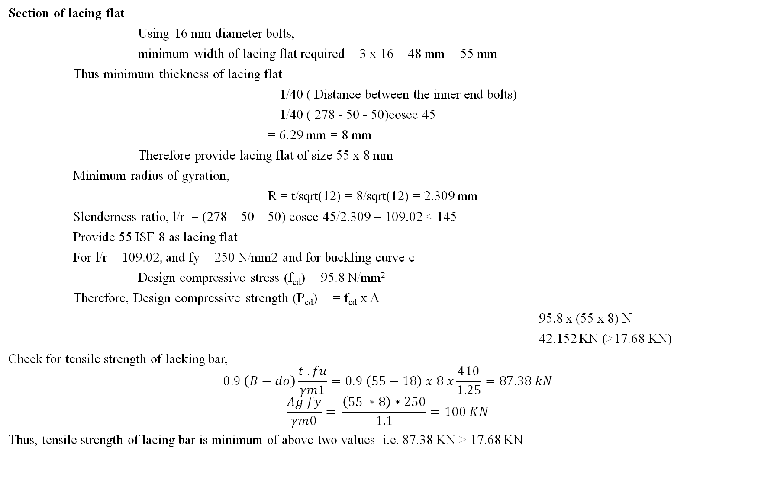
Section of lacing flat
Using 16 mm diameter bolts,
minimum width of lacing flat required = 3 x 16 = 48 mm = 55 mm
Thus minimum thickness of lacing flat
= 1/40 ( Distance between the inner end bolts)
= 1/40 ( 278 - 50 - 50)cosec 45
= 6.29 mm = 8 mm
Therefore provide lacing flat of size 55 x 8 mm
Minimum radius of gyration,
R = t/sqrt(12) = 8/sqrt(12) = 2.309 mm
Slenderness ratio, l/r = (278 – 50 – 50) cosec 45/2.309 = 109.02 < 145
Provide 55 ISF 8 as lacing flat
For l/r = 109.02, and fy = 250 N/mm2 and for buckling curve c
Design compressive stress (f_{cd}) = 95.8 N/mm²
Therefore, Design compressive strength (P_{cd}) = f_{cd} x A
= 95.8 x (55 x 8) N
= 42.152 KN (>17.68 KN)
Check for tensile strength of lacking bar,
$$0.9 \left(B−do\right)\frac{t . fu}{γm1}=0.9 \left(55−18\right) x 8 x\frac{410}{1.25}=87.38 kN$$
$$\frac{Ag fy}{γm0}= \frac{\left(55 ∗8\right)∗250}{1.1}=100 KN$$
Thus, tensile strength of lacing bar is minimum of above two values i.e. 87.38 KN > 17.68 KN

Slide 42
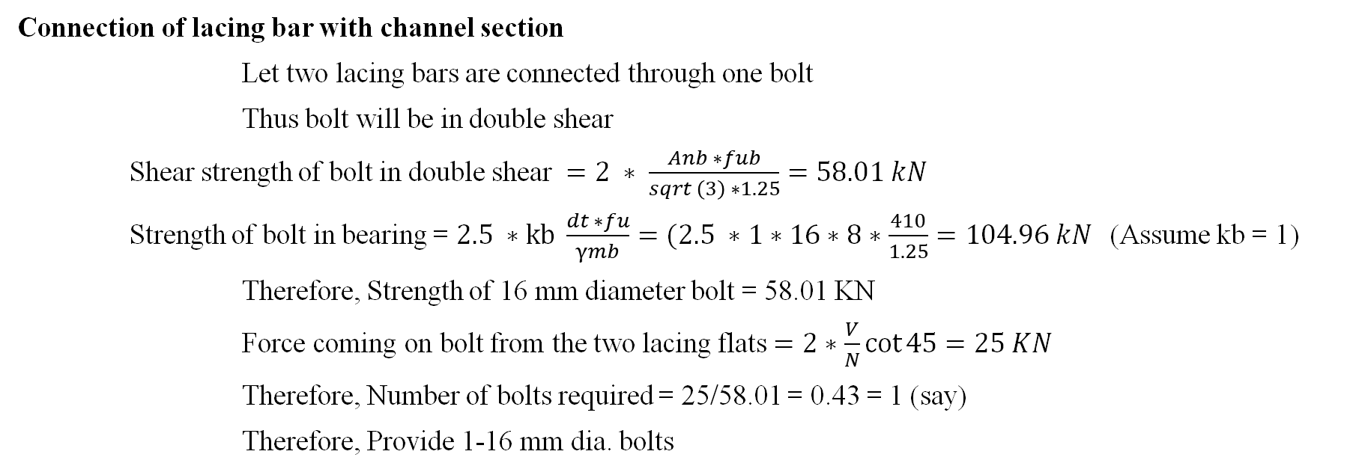
Connection of lacing bar with channel section
Let two lacing bars are connected through one bolt
Thus bolt will be in double shear
Shear strength of bolt in double shear $=2 ∗ \frac{Anb ∗fub}{sqrt \left(3\right) ∗1.25}=58.01 kN$
Strength of bolt in bearing = $2.5 ∗kb \frac{dt ∗fu}{γmb}=(2.5 ∗1∗16∗8∗\frac{410}{1.25}=104.96 kN$(Assume kb = 1)
Therefore, Strength of 16 mm diameter bolt = 58.01 KN
Force coming on bolt from the two lacing flats $=2∗\frac{V}{N}\cot{45}=25 KN$
Therefore, Number of bolts required = 25/58.01 = 0.43 = 1 (say)
Therefore, Provide 1-16 mm dia. bolts

Slide 43
Design of lacing, Battering and Column bases
Codal Requirement
IS 800:2007 Steel table
Example 1 Design a build up column to carry an axial load of 666.67kN which is 5.5m long hinged at both ends. Design the associated lacing system also. Use steel of grade Fe410 and bolts of grade 4.6. only available section is channel section. Explain all possible arrangement of channel section.
Solution : Design load is 666.67KN , factored load = 1.5*666.67 = 1000KN
For Fe 410, f_{u} = 410 N/mm², f_{y =} 250N/mm²
Let bolts of grade 4.6 are used and thus f_{ub=}400N/mm²
Factor od safety for angle material ¥_{mo} = 1.10
Factor od safety for angle material ¥_{mb} = 1.25
For preliminary design, let design compressive stress, f_{cd}=150N/mm²
Cross section area required A=P/ f_{cd, where} P = 1000kN
= 1000*1000/150 = 6666.67mm²

Slide 44
Designati on | Weight per Mete (w) | Sectional Area (a) | Depth of Section (h) | Width of flange (b) | Thickness of Flange (t_{f}) | Thicknes s of Web (t_{w}) | Centre of Gravity Cyy | Ixx cm4 | Iyy cm4 | Raddi of Gyration rxx | Raddi of Gyration ryy | Modulli of Section Zxx | Modulli of Section Zyy | Connection Details |  |  |  |  |  | Maximum size of Flange Rivet | Designati on
 | kg | cm² | mm | mm | mm | mm | cm |  |  | cm | cm | cm³ | cm³ | h₁ | h2 | b1/2 | C | g | g₁ | mm
 |  |  |  |  |  |  |  |  |  |  |  |  |  | mm | mm | mm | mm | mm | (min) mm
ISMC 75 | 6.8 | 8.67 | 75 | 40 | 7.3 | 4.4 | 1.31 | 76 | 12.6 | 2.96 | 1.21 | 20.3 | 4.7 | 41.4 | 16.8 | 17.8 | 5.9 | 21 | 50 | 12 | ISMC 75
ISMC 100 | 9.2 | 11.7 | 100 | 50 | 7.5 | 4.7 | 1.53 | 186.7 | 25.9 | 4 | 1.49 | 37.3 | 7.5 | 64 | 18 | 22.7 | 6.2 | 28 | 50 | 16 | ISMC 100
ISMC 125 | 12.7 | 16.19 | 125 | 65 | 8.1 | 5 | 1.94 | 416.4 | 59.9 | 5.07 | 1.92 | 66.6 | 13.1 | 85.4 | 19.8 | 30 | 6.5 | 35 | 55 | 22 | ISMC 125
ISMC 150 | 16.4 | 20.88 | 150 | 75 | 9 | 5.4 | 2.22 | 779.4 | 102.3 | 6.11 | 2.21 | 103.9 | 19.4 | 106.7 | 21.7 | 34.8 | 6.9 | 40 | 55 | 25 | ISMC 150
ISMC 175 | 19.1 | 24.38 | 175 | 75 | 10.2 | 5.7 | 2.2 | 1223.3 | 121 | 7.08 | 2.23 | 139.8 | 22.8 | 128.4 | 23.3 | 34.7 | 7.2 | 40 | 55 | 25 | ISMC 175
ISMC 200 | 22.1 | 28.21 | 200 | 75 | 11.4 | 6.1 | 2.17 | 1819.3 | 140.4 | 8.03 | 2.23 | 181.9 | 26.3 | 150.2 | 24.9 | 34.5 | 7.6 | 40 | 60 | 25 | ISMC 200
ISMC 225 | 25.9 | 33.01 | 225 | 80 | 12.4 | 6.4 | 2.3 | 2694.6 | 187.2 | 9.03 | 2.38 | 239.5 | 32.8 | 170.9 | 27.1 | 36.8 | 7.9 | 45 | 60 | 25 | ISMC 225
ISMC 250 | 30.4 | 38.67 | 250 | 80 | 14.1 | 7.1 | 2.3 | 3816.8 | 219.1 | 9.94 | 2.38 | 305.3 | 38.4 | 192.5 | 28.7 | 36.5 | 8.6 | 45 | 65 | 25 | ISMC 250
ISMC 300 | 35.8 | 45.64 | 300 | 90 | 13.6 | 7.6 | 2.36 | 6362.8 | 310.8 | 11.81 | 2.61 | 424.2 | 46.8 | 240.7 | 29.6 | 41.2 | 9.1 | 50 | 65 | 28 | ISMC 300
ISMC 350 | 42.1 | 53.66 | 350 | 100 | 13.5 | 8.1 | 2.44 | 10008 | 430.6 | 13.66 | 2.83 | 571.9 | 51 | 288.1 | 30.9 | 46 | 9.6 | 60 | 65 | 28 | ISMC 350
ISMC 400 | 49.4 | 62.93 | 400 | 100 | 15.3 | 8.6 | 2.42 | 15082.8 | 504.8 | 15.48 | 2.83 | 754.1 | 66.6 | 332.8 | 33.6 | 45.7 | 10.1 | 60 | 70 | 28 | ISMC 400
Try ISMC 250@298.2N/m
Thus, area provided by 2 ISMC 250 = 2*3867 = 7734mm² > 6666.67mm²

Slide 45
The advantage of build up column is that least radius of gyration can be increased so that is lest radios of gyration can be made more at least equal to r_{zz} i.e.
r_{min} =r_{zz} this is done by adjusting spacing between the sections.
Effective length = kL = 1*5.5 = 5.5m
For effective slenderness ratio
(kL/r) _{e} = 58.09 and f_{y} 250N/mm² and for buckling curve “C”
Design compressive stress (f_{cd}) = 170.85 N/mm²
Design compressive strength (P_{cd}) = f_{cd*}A = 170.85*(2*3867) N = 1321.37 KN
1321.37 kN > 1000kN
Now minimum radius of gyration (ʎ_{min}) = r_{z} | = 99.4mm
Slenderness ration ʎ = kL/ r_{z} = 5500/99.4 | = 55.33
Effective slenderness ratio (ʎ_{e}) = 1.05*55.33 | = 58.09 < 180 …. Ok
ISMC 250@298.2N/m | is ……………………………………………………………. | over safe

Slide 46
Buckling class C table for f_{cd} value
Thus, Try ISMC 225
For effective slenderness ratio
(kL/r)_{e} = 63.95 and f_{y} 250N/mm² and for buckling curve “C”
Design compressive stress (f_{cd}) = 161.67N/mm²
Design compressive strength (P_{cd}) = f_{cd*}A = 161.67*(2*3301) N = 1067.37KN
1067.37 kN > 1000kN … ok
Thus, ISMC 225 is safe
kL/r | 10 | 20 | 30 | 40 | 50 | 60 | 70 | 80 | 90 | 100 | 110 | 120 | 130 | 140 | 150 | 160 | 170 | 180 | 190 | 200 | 210 | 220 | 230 | 240 | 250
F_{cd} | 227 | 224 | 211 | 198 | 183 | 168 | 152 | 136 | 121 | 107 | 94.6 | 83.7 | 74.3 | 66.2 | 59.2 | 53.3 | 48.1 | 43.6 | 39.7 | 36.3 | 33.3 | 30.6 | 28.3 | 26.2 | 24.3
f | 0.3 | 1.3 | 1.3 | 1.5 | 1.5 | 1.6 | 1.6 | 1.5 | 1.4 | 1.24 | 1.09 | 0.94 | 0.81 | 0.7 | 0.59 | 0.52 | 0.45 | 0.39 | 0.34 | 0.3 | 0.27 | 0.24 | 0.21 | 0.19
area provided by 2 ISMC 225 = 2*3301 | = 6602 mm²
Now minimum radius of gyration (ʎ_{min}) | = r_{z} = 90.3mm
Slenderness ration ʎ = kL/ r_{z} | = 5500/90.3 = 60.90
Effective slenderness ratio (ʎ_{e}) | = 1.05*60.90 = 63.95 < 180 …. Ok

Slide 47
A) Arrangement 1 – Channels are placed back to back
The channels are so spaced that
M.O.I. _{z} = M.O.I. _{y}
2I_{z} = 2(I_{y} + A(S/2 + C_{yy})²)
2*2694.6*10000 = 2(187.2*10000 + 3301 (S/2 + 23.6)²)
S = 120.47 mm = 120.47 mm
Thus place channels back to back at a spacing of 120.47 mm
Design of lacings
Let lacing are inclined at 45 deg with the horizontal
Thus length of channel between lacings = (120.47 +45+45)cot45 * 2 = 420.94 mm
Therefore, Slenderness ratio of portion of channel between lacings
= 420.94/r_{y} = 440.95/23.8 = 18.3 < 50 (OK)
Also, 0.7 (kL/r)_{e} = 0.7 x 63.95 = 44.76 > 18.52 (OK)
Design shear for lacing (V0 = 2.5% of axial load = 2.5/100 x 1000 = 25 KN
Therefore, shear in each plane = V/N = 2.5/2 = 12.5 KN
Therefore, compressive force in the lacing bars = (V/N) *cosec (45) = 17.68 KN
120.47

Slide 48
Section of lacing flat
Using 16 mm diameter bolts, minimum width of lacing flat required = 3 x 16 = 48 mm = say 55 mm
Thus minimum thickness of lacing flat
= 1/40 ( Distance between the inner end bolts)
= 1/40 ( 120.47 + 45 +45)cosec 45
= 5.26 mm = say 8 mm
Therefore provide lacing flat of size 55 x 8 mm( 55 ISF 8mm)
Minimum radius of gyration,
R = t/sqrt(12) = 8/sqrt(12) = 2.30
Length of lacing is 420.94 and consider both end fixed, so K = 0.5
Slenderness ratio, KL/r = 210.47 cosec 45/2.30 = 129 < 145 OK
For KL/r = 129 , f_{y} = 250 N/mm² and for buckling curve c
Design compressive stress (f_{cd}) = 75.24 N/mm²
Therefore, Design compressive strength (P_{cd}) = f_{cd} x A
= 75.24 x (55 x 8) N
= 33.10 KN (>17.68 KN)

Slide 49
Check for tensile strength of lacking bar,
$$0.9 \left(B−do\right)\frac{t . fu}{γm1}=0.9 \left(55−18\right) x 12 x\frac{410}{1.25}=131.07 kN$$
$$\frac{Ag fy}{γm0}= \frac{\left(55 ∗12\right)∗250}{1.1}=150 KN$$
Thus, tensile strength of lacing bar is minimum of above two values i.e. 131.07 KN > 17.68 KN
Connection of lacing bar with channel section
Let two lacing bars are connected through one bolt
Thus bolt will be in double shear
Shear strength of bolt in double shear $=2 ∗ \frac{Anb ∗fub}{sqrt \left(3\right) ∗1.25}=58.01 kN$
Strength of bolt in bearing = $2.5 ∗kb \frac{dt ∗fu}{γmb}=(2.5 ∗1∗16∗12∗\frac{410}{1.25}=157.44 kN$(Assume kb = 1)
Therefore, Strength of 16 mm diameter bolt = 58.01 KN
Force coming on bolt from the two lacing flats $=2∗\frac{V}{N}\cot{45}=25 KN$
Therefore, Number of bolts required = 25/58.01 = 0.43 = 1 (say)
Therefore,
Provide 1-16 mm dia. bolts

Slide 50
B) Arrangement 2 – Channels are placed face to face
The channels are so spaced that
M.O.I._{z} = M.O.I._{y}
2I_{z} = 2(I_{y} + A(S/2 - C_{yy})²)
2*2694.6*10000 = 2(187.2*10000 + 3301 (S/2 - 23.6)²)
S = 221.50 mm = 221.50 mm
Thus place channels face to face at a spacing of 221.50 mm
Design of lacings
Let lacing are inclined at 45 deg with the horizontal
Thus length of channel between lacings = (221.50 – 45 - 45)cot45 * 2 = 263 mm
Therefore, Slenderness ratio of portion of channel between lacings
= 263/r_{y} = 356/23.8 = 11.05 < 50 (OK)
Also, 0.7 (kL/r)_{e} = 0.7 x 63.95 = 44.765 > 11.05 (OK)
Design shear for lacing (V₀ = 2.5% of axial load = 2.5/100 x 1000 = 25 KN
Therefore, shear in each plane = V/N = 2.5/2 = 12.5 KN
Therefore, compressive force in the lacing bars = V cosec (45)/N = 17.68 KN
221.50

Slide 51
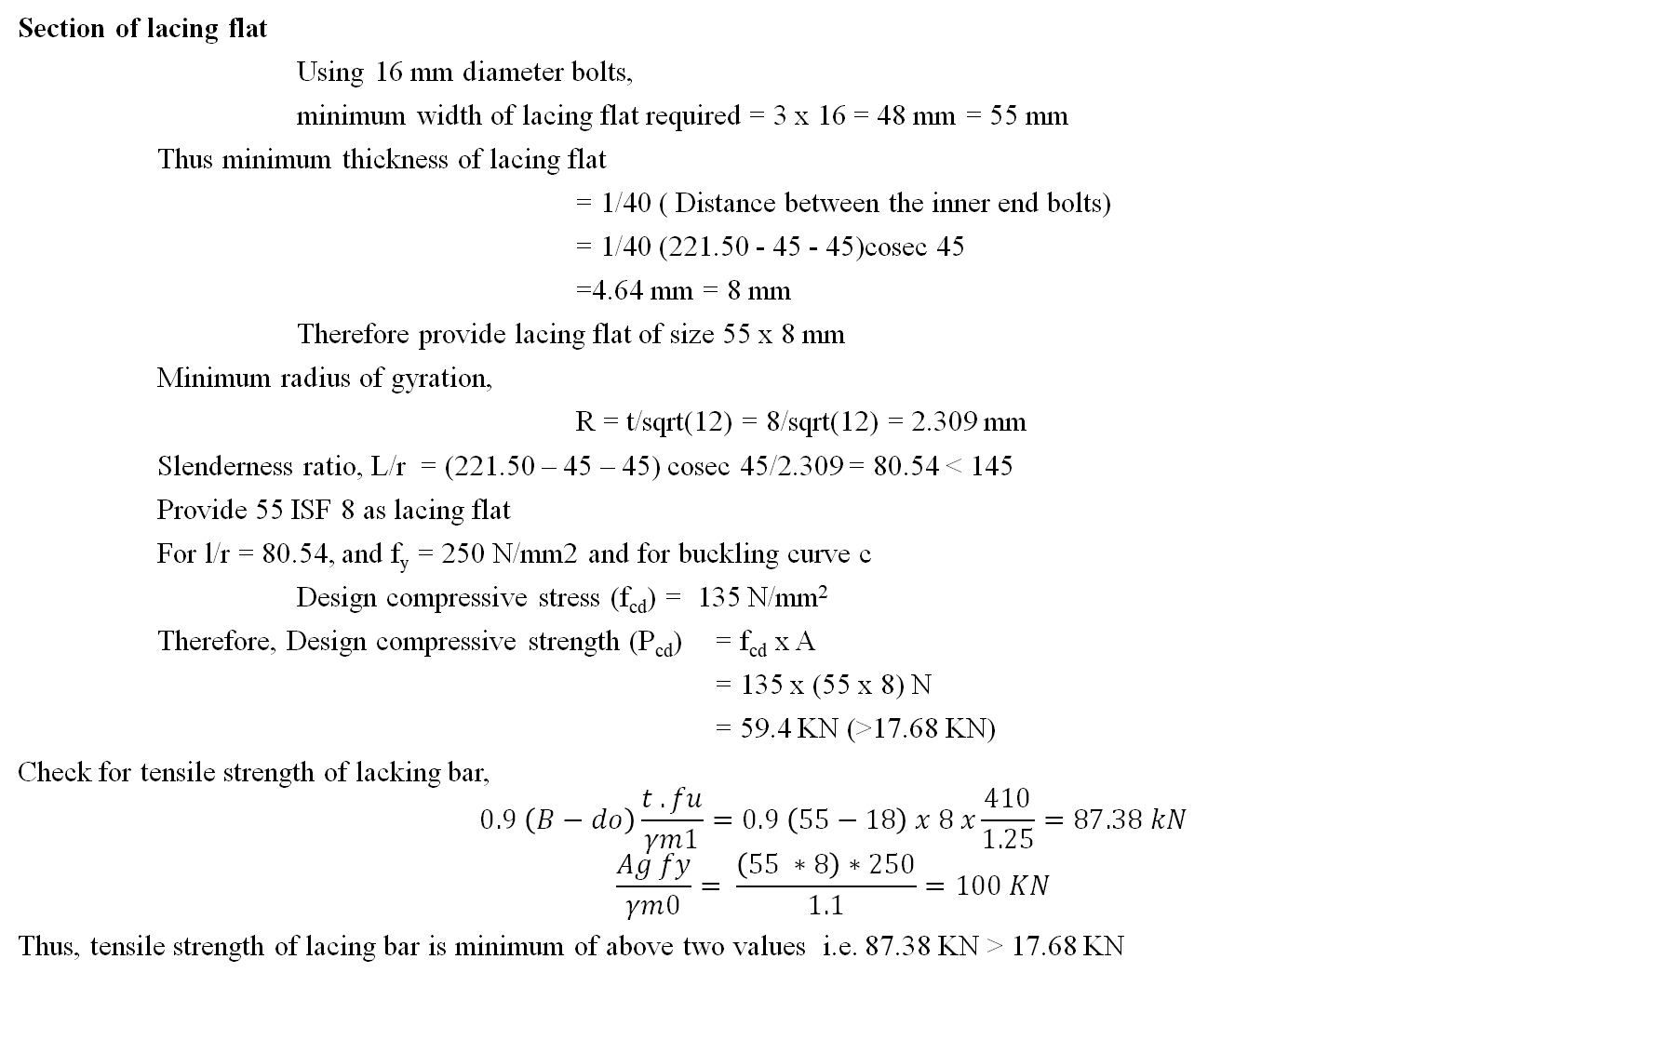
Section of lacing flat
Using 16 mm diameter bolts,
minimum width of lacing flat required = 3 x 16 = 48 mm = 55 mm
Thus minimum thickness of lacing flat
= 1/40 ( Distance between the inner end bolts)
= 1/40 (221.50 - 45 - 45)cosec 45
=4.64 mm = 8 mm
Therefore provide lacing flat of size 55 x 8 mm
Minimum radius of gyration,
R = t/sqrt(12) = 8/sqrt(12) = 2.309 mm
Slenderness ratio, L/r = (221.50 – 45 – 45) cosec 45/2.309 = 80.54 < 145
Provide 55 ISF 8 as lacing flat
For l/r = 80.54, and f_{y} = 250 N/mm2 and for buckling curve c
Design compressive stress (f_{cd}) = 135 N/mm²
Therefore, Design compressive strength (P_{cd}) = f_{cd} x A
= 135 x (55 x 8) N
= 59.4 KN (>17.68 KN)
Check for tensile strength of lacking bar,
$$0.9 \left(B−do\right)\frac{t . fu}{γm1}=0.9 \left(55−18\right) x 8 x\frac{410}{1.25}=87.38 kN$$
$$\frac{Ag fy}{γm0}= \frac{\left(55 ∗8\right)∗250}{1.1}=100 KN$$
Thus, tensile strength of lacing bar is minimum of above two values i.e. 87.38 KN > 17.68 KN

Slide 52
Connection of lacing bar with channel section
Let two lacing bars are connected through one bolt
Thus bolt will be in double shear
Shear strength of bolt in double shear $=2 ∗ \frac{Anb ∗fub}{sqrt \left(3\right) ∗1.25}=58.01 kN$
Strength of bolt in bearing = $2.5 ∗kb \frac{dt ∗fu}{γmb}=(2.5 ∗1∗16∗8∗\frac{410}{1.25}=104.96 kN$(Assume kb = 1)
Therefore, Strength of 16 mm diameter bolt = 58.01 KN
Force coming on bolt from the two lacing flats $=2∗\frac{V}{N}\cot{45}=25 KN$
Therefore, Number of bolts required = 25/58.01 = 0.43 = 1 (say)
Therefore, Provide 1-16 mm dia. bolts

